Slide 1


SUPERFOODSMAX
Lifting Sales Revenue by 5% in the next 2 years
- by Bua Le Guern

Slide 2
About us
SuperFoodsMax is a national grocery chain with stores all across Australia.
8% of the national grocery market share.
Offer most of the products and brands sold by the ‘big three’ in the sector.

Slide 3
business question How to lift Sales Revenue by 5% in the next 2 years

Slide 4
Evaluating business request for data analysis to support informed decision making.
What age band are more likely to shop with SuperFoodsMax in next 2 years
How to increase revenue from that least contributing age group
How to increase the loyalty of the customers

Slide 5
Acquiring and evaluating the relevant data
The open source data set ‘dataset_2019_2022.csv’(only 1 dataset) used in this analysis is from RMITO (data is sourced externally)
The data we have is on customer transactions and product purchases to strategically boost our market shares.
By analysing the purchasing behaviours of present customers, the company can
extend that insight to allure new consumers
and encouraging current customers to buy more products frequently.
The transactional data covers - Customer Ids , Product Ids, Basket Ids, Loyalty Types, Household Type(s), Age Band, Departments, Brand, Commodity, Store, Price, Transaction Dates
The data is analysed from only one store having transactions
in 2019,2020 and 2021.

Slide 6
CLEANING and formatting the data

Slide 7
Legal and ethical considerations
Privacy – Data is public and is available for public use by SuperFoodsMax
Identity – No personal data is captured by SuperFoodsMax
Shared data - SuperFoodsMax permits unrestricted data sharing for unbiased decision-making and predictions.
Transparency – SuperFoodsMax have informed users while capturing their data, also highlighting the use of it.
Predictions - Decisions and predictions based on the freely available SuperFoodsMax dataset will adhere to legal and ethical standards, including GDPR and Privacy Act 1988.
Bias - Aim for unbiased data analytics, prioritizing factual information to improve revenue in SuperFoodsMax is done.
Honesty - Data is accurately depicted to enhance revenue in SuperFoodsMax, ensuring integrity and no manipulation in analysis.

Slide 8
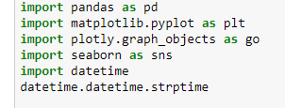

Data Cleaning
Data cleaning in python was done using inbuilt functions in Pandas library as below:
Importing Libraries -
Getting excel data in dataframe –
reset_index() – reset index on dataframe was done to avoid any duplication or missing of index values and to set sequential numbers as the index.
drop_duplicates() – This function was used on data frame to remove duplicate customers.
(50 duplicates were removed, verified by counting rows in df before and after duplicates.)

Slide 9
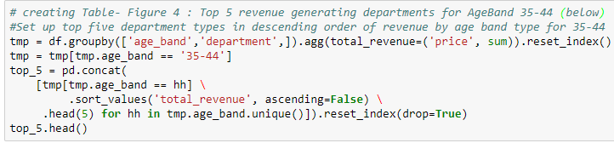
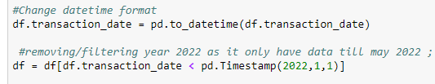
Data wrangling and formatting
groupby() – grouping data frame by loyalty, age_band, department column is done to manipulate the data frame for desired graphs, charts and tables.
sort_values() – values were sorted in data frame by descending order on ‘Revenue’ column to show top five revenue generating departments by age band type for 35-44
Filtering the data until 2022 - 2022 Data was removed as we only have data of first quarter of 2022. This was done by changing the format of transaction date column in df, thereafter, filtering it for less than 1 Jan 2022.

Slide 10
Applying data analytics using python & visualising data using pandas

Slide 11
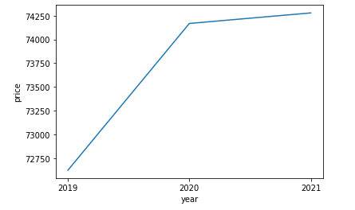
Revenue in last 3 years
Descriptive Analysis
Data from 2019-2021
Revenue (in $) increasing
2022 data excluded as incomplete
Figure 0 : Total revenue in last 3 years

Slide 12
what age band are MORE likely to shop with sUperfoodSmax in next 2 years

Slide 13
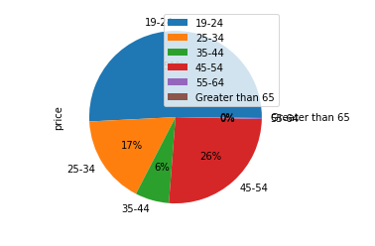
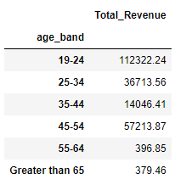
Using the diagnostic & predictive analysis over last 3 years (2019-2021) of data from SuperFoodsMax transactions, we can see that most revenue is generated via age band 19-24, i.e 51% appx. of overall sales. Thus, its safe to predict that this age group would be shopping with SuperFoodsMax in next 2 years.
Figure 2 : Age Band total revenue in SuperFoodsMax
Figure 1 : Age Group percentage in SuperFoodsMax

Slide 14
HOW TO INCREASE REVENUE FROM a specific age band CONTRIBUTING IN THE LEAST SALES with sUperfoodSmax in next 2 years

Slide 15
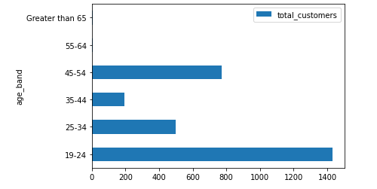
As we saw in pie chart, the least contributing sales over last 3 years (2019-2021) is age band 55-64 and greater than 65.
We used another bar chart to see how many customers we have for each age group
As we can see we have least customers from age band 55-64 and greater than 65, which explains their least contribution in Revenue.
But we wont be focusing on increasing the revenue in these age groups as they
are on budget planning as they mainly rely on pension and some are in age care
45-54 age group is second highest performing, leaving the age band 35-44
in least revenue contribution
Analysing above insights, we would be focusing on increasing revenue on age band 35-44
Figure 3 : Age Band total customers as per Age-Band

Slide 16
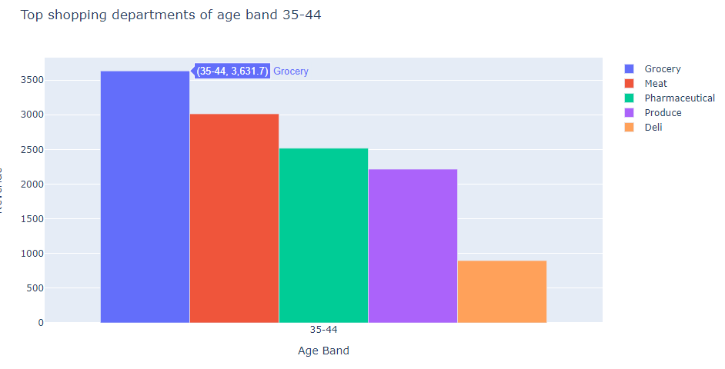
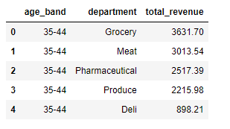
From the Bar graph and table created below using diagnostic analysis, we can see that most shopping of age band 35-44 is in the following departments :
Grocery
Meat
Pharmaceutical
Produce
Deli
Figure 4 : Top 5 revenue generating departments for AgeBand 35-44
Figure 5 : Bar graph of Top 5 revenue generating departments for AgeBand 35-44

Slide 17
Using the diagnostic and prescriptive analysis on graphs, and tables created before, we can prescribe following techniques to retain the customers from age band 35-44:
Give more competitive prices on commodities under type ’Grocery’
Keep the meat fresh from butchers rather selling more packaged and frozen meats. This can include strategies like longer working hours or more hiring for butchers.
Having more fresh produce with longer expiries and competitive prices.
Offering discounts like super saver hour for Deli on Friday, Saturday & Sunday as Deli is consumed more with weekend beverages.

Slide 18
HOW TO INCREASE LOYALTY of customers with sUperfoodSmax in next 2 years

Slide 19
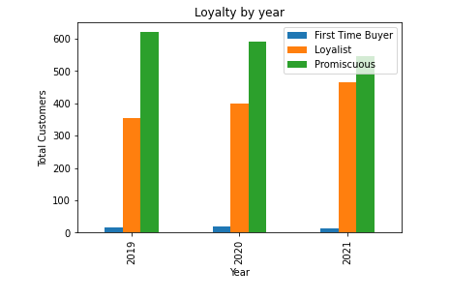
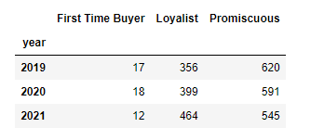
From the Bar graph and table created below via diagnostic analysis, we can see that :
First time buyers have reduced which is good as they can be in other 2 segments
Promiscuous customers have reduced as they have converted into Loyalist
Loyalist customers have increased
Figure 7 : Loyalty segments in last 3 years
Figure 6 : Bar graph of Loyalty segments in last 3 years

Slide 20
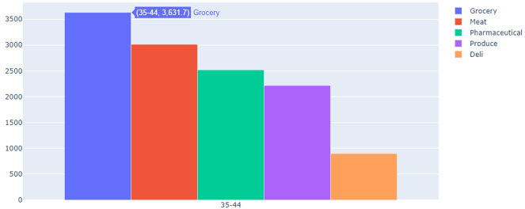
Suggestions using prescriptive analysis
Converting customers into ‘Loyalist’ segment by :
Provide more value and competitive prices to the shoppers.
Introduce reward system for the shoppers encouraging first time buyers to come back
Provide discount to ‘Loyalist’ customers segment encouraging customer conversion to ‘loyalist’
Introduce self-checkouts and express checkouts as its preferred by young and quick shoppers buying small quantity of groceries.
Increase the Deli variety section
as this is our less revenue area.

Slide 21
Thank you

